Slide 1
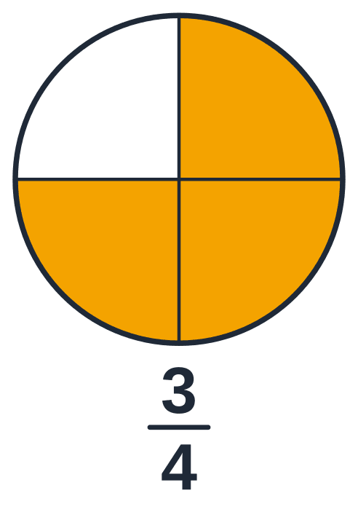
Lessons 1 to 3, up to Example 5
Business Maths 102
CATCH-UP SESSION
Times means "groups of" · what a fraction is · simplifying · multiplying fractions · a fraction OF an amount
Notes:
Catch-up session: Catch-up: the core of Lessons 1 and 2, and Lesson 3 up to Example 5.
Share this deck full-screen. One click = one new line on the "board". Slide numbers are bottom right, so anyone following the PDF on a phone can keep up when you say the number.

Slide 2
By the end of today you can…
TODAY
1
Use the times table to multiply and divide, and say what × means ("groups of")
2
Say what the top and the bottom of a fraction mean, and simplify a fraction
3
Change an improper fraction into a mixed number, and back again
4
Multiply a whole number by a fraction, and a fraction by a fraction
5
Find a fraction OF an amount: divide by the bottom, then multiply by the top
Notes:
Read the goals out. Say: "If you can do these by the end, today worked. If not, tell me which one — that is what the exit ticket is for."

Slide 3
Times and divide, with the times table
PART 1 OF 7 · FROM LESSON 1 · about 10 minutes
1
The sign × means "groups of". Dividing asks "how many groups fit?"
Notes:
Part 1 of 7: Times and divide, with the times table. The sign × means "groups of". Dividing asks "how many groups fit?"

Slide 4
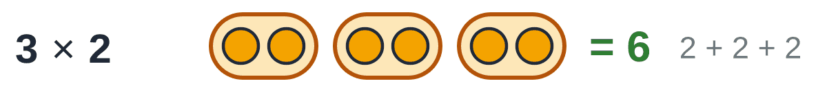
The sign × is read "times". It means "groups of"
PICTURE IT
3 × 2 is read "3 times 2". It means 3 groups of 2.
Count the dots: 2 + 2 + 2 = 6.
So multiplying is a quick way of adding the same number again and again.
Notes:
SAY: Ask: "What does 4 × 5 mean in words?" (4 groups of 5.) "How could you work it out if you forgot your tables?" (5 + 5 + 5 + 5 = 20.)

Slide 5
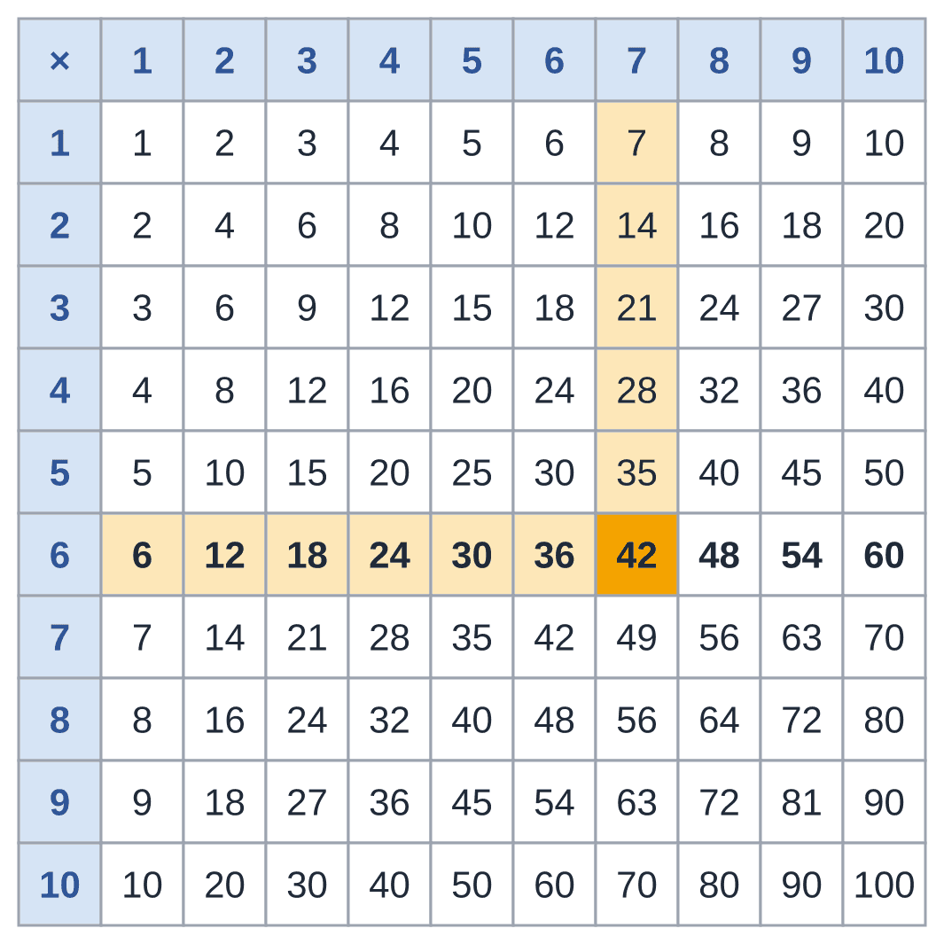
The times table: keep it next to you all session
TOOL
To find 6 × 7: put a finger on row 6 and slide along to column 7. You land on 42.
To divide, go backwards. For 42 ÷ 6, look along row 6 for 42. It sits under the 7, so 42 ÷ 6 = 7.
Nobody has to know the tables by heart. Keep this page open in your notes.
Notes:
SAY: Do one together: "Find 8 × 4." (Row 8, column 4: 32.) And one backwards: "32 ÷ 8?" (Row 8, find 32, look up: 4.)

Slide 6
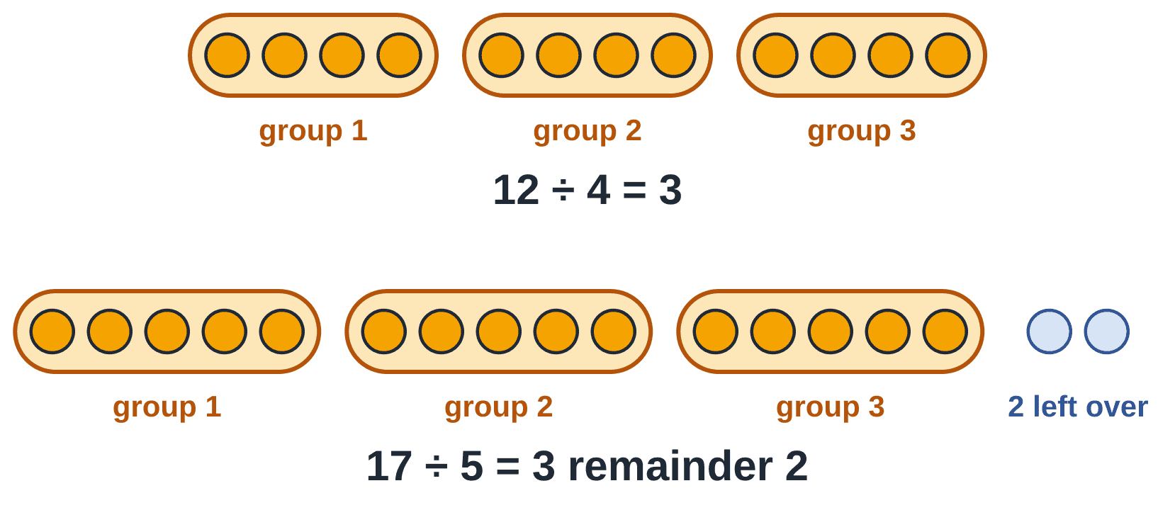
Dividing asks: how many groups fit?
PICTURE IT
12 ÷ 4 asks: how many groups of 4 fit into 12?
Make groups of 4: three groups fit exactly. So 12 ÷ 4 = 3.
Sometimes a few are left over. That is the remainder: 17 ÷ 5 = 3 remainder 2.
Notes:
SAY: Dividing is also sharing: 12 sweets shared by 4 people gives 3 each. Same answer.

Slide 7
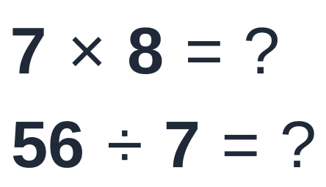
Your go: 7 × 8, and 56 ÷ 7
QUICK CHECK
Use the times table. Type the two answers.
?
Type your answer in the chat
Notes:
QUICK CHECK. Read the question out. Everyone types an answer in the chat before you click on. Wait for at least half the group. No answers out loud yet.
Expect "56, 8".

Slide 8
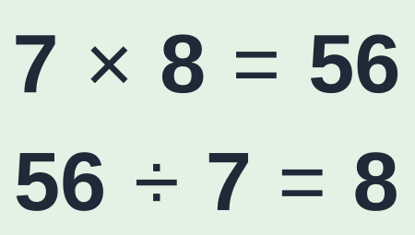
Your go: 7 × 8, and 56 ÷ 7
QUICK CHECK
Use the times table. Type the two answers.
ANSWER
Row 7, column 8 gives 56. Backwards: find 56 in row 7. It sits under the 8.
Notes:
ANSWER:
WHY: Row 7, column 8 gives 56. Backwards: find 56 in row 7. It sits under the 8.
Name two people whose chat answers were right. If many were wrong, go back one slide and re-explain before moving on.

Slide 9
What a fraction is, and how to simplify it
PART 2 OF 7 · FROM LESSON 2 · about 20 minutes
2
The top counts the slices. The bottom says how many equal slices make one whole
Notes:
Part 2 of 7: What a fraction is, and how to simplify it. The top counts the slices. The bottom says how many equal slices make one whole

Slide 10
A pizza is cut into 4 equal slices. You eat 1
PICTURE IT
The whole pizza was cut into 4 equal slices.
3 slices are left.
We write what is left as 3/4.
We say "three quarters", or "three out of four".
Notes:
SAY: Before you click, ask: "How many slices was the pizza cut into? How many are left?"

Slide 11
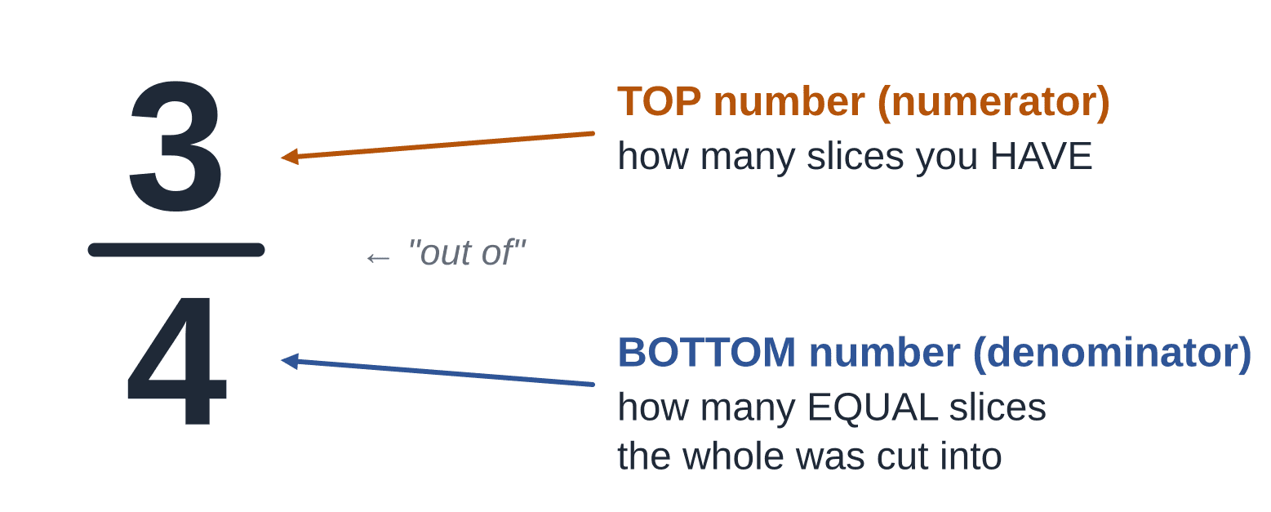
Each number in a fraction has its own job
WORDS TO KNOW
The bottom number says how many equal slices make one whole. Here it is 4, so the slices are quarters.
The top number counts how many slices you have. Here it is 3.
The module guide calls the top the numerator and the bottom the denominator. (Denominator: Down.)
Notes:
SAY: The bottom number NAMES the slices (quarters). The top number COUNTS them (three).

Slide 12
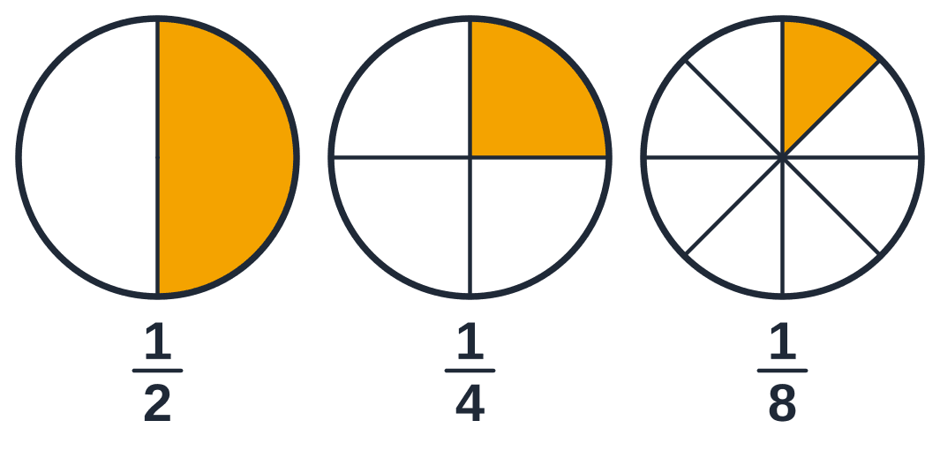
A bigger bottom number means SMALLER slices
PICTURE IT
Cut the same pizza into more slices, and each slice gets smaller.
So 1/8 is smaller than 1/4, even though 8 is bigger than 4.
Notes:
SAY: Ask: would you rather share a pizza with 2 people or with 8?

Slide 13
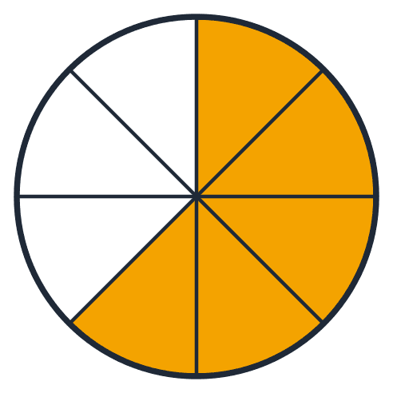
Your go: what fraction is orange?
QUICK CHECK
Count the slices. Type the fraction like this: top/bottom
?
Type your answer in the chat
Notes:
QUICK CHECK. Read the question out. Everyone types an answer in the chat before you click on. Wait for at least half the group. No answers out loud yet.

Slide 14
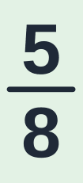
Your go: what fraction is orange?
QUICK CHECK
Count the slices. Type the fraction like this: top/bottom
ANSWER
The pizza has 8 equal slices: that is the bottom. 5 of them are orange: that is the top.
Notes:
ANSWER:
WHY: The pizza has 8 equal slices: that is the bottom. 5 of them are orange: that is the top.
Name two people whose chat answers were right. If many were wrong, go back one slide and re-explain before moving on.

Slide 15
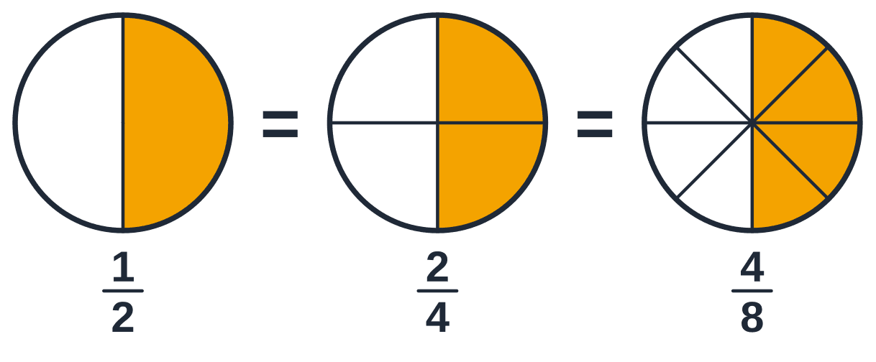
Half a pizza is half a pizza, however you cut it
PICTURE IT
All three pizzas have the same amount coloured.
Only the number of cuts is different.
So 1/2, 2/4 and 4/8 are the same amount.
Notes:
All three pizzas have the same amount coloured. Only the number of cuts is different. So 1/2, 2/4 and 4/8 are the same amount.

Slide 16
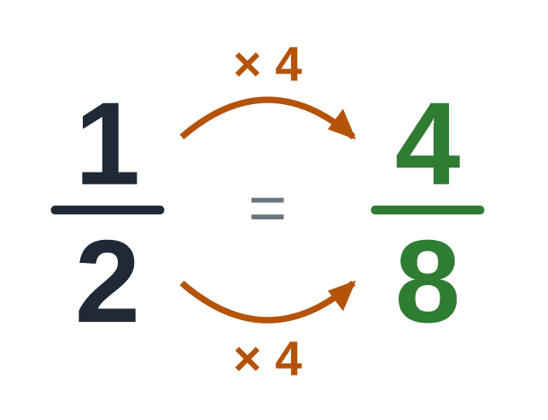
The golden rule of fractions
THE RULE
You may multiply the top and the bottom by the same number.
You may divide the top and the bottom by the same number.
The amount does not change. Only the numbers do.
Notes:
SAY: Have her say it back: "Whatever I do to the bottom, I do to the top."

Slide 17
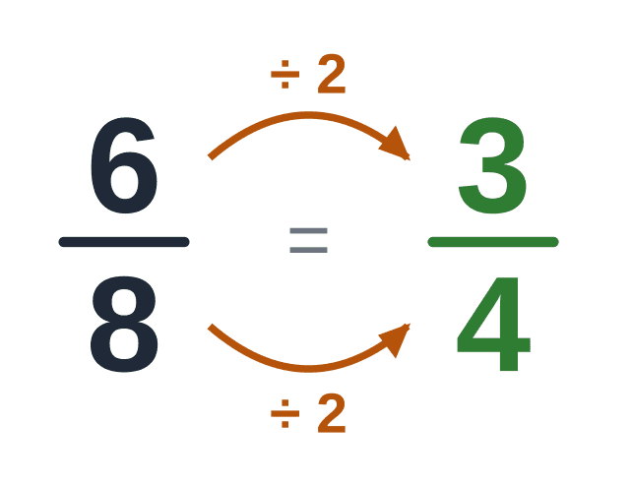
Simplifying: the same amount with smaller numbers
WORDS TO KNOW
To simplify, divide the top and the bottom by a number that goes into both.
"Goes into" means it divides exactly, with nothing left over.
Keep going until 1 is the only number that goes into both. Then the fraction is finished.
The exam says "reduced to the lowest term". It means the same thing.
Notes:
To simplify, divide the top and the bottom by a number that goes into both. "Goes into" means it divides exactly, with nothing left over. Keep going until 1 is the only number that goes into both. Then the fraction is finished. The exam says "reduced to the lowest term". It means the same thing.

Slide 18
Quick tests: does it go in exactly?
TOOL
Goes in? | The test | Example
2 | The last digit is even: 0, 2, 4, 6 or 8. | 36 ends in 6 ✓
3 | Add the digits. The total is in the 3 times table. | 45: 4 + 5 = 9 ✓
5 | The last digit is 0 or 5. | 45 and 60 ✓
10 | The last digit is 0. | 60 ✓
Notes:
Stuck? Look for a row of the times-table grid, other than row 1, that has BOTH numbers in it.

Slide 19
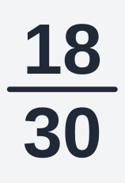
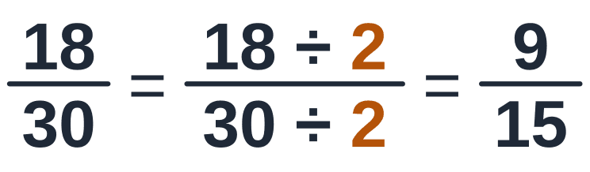
Example 1: simplify in small steps
WORKED EXAMPLE
Simplify:
1
STEP 1 OF 3
Find a number that goes into BOTH 18 and 30. Both are even, so 2 goes into both. Divide the top and the bottom by 2.
Why? Half of 18 is 9. Half of 30 is 15.
Notes:
Example 1: simplify in small steps — step 1 of 3.
DO: Find a number that goes into BOTH 18 and 30. Both are even, so 2 goes into both. Divide the top and the bottom by 2.
WHY: Half of 18 is 9. Half of 30 is 15.

Slide 20
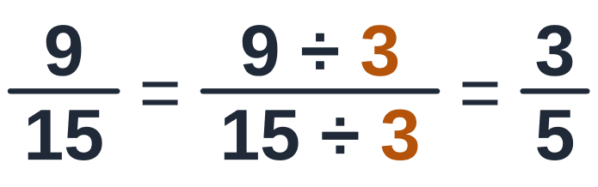
Example 1: simplify in small steps
WORKED EXAMPLE
Simplify:
2
STEP 2 OF 3
Look again. 9 and 15 are both in the 3 times table. Divide the top and the bottom by 3.
Why? 9 ÷ 3 = 3 and 15 ÷ 3 = 5.
Notes:
Example 1: simplify in small steps — step 2 of 3.
DO: Look again. 9 and 15 are both in the 3 times table. Divide the top and the bottom by 3.
WHY: 9 ÷ 3 = 3 and 15 ÷ 3 = 5.

Slide 21
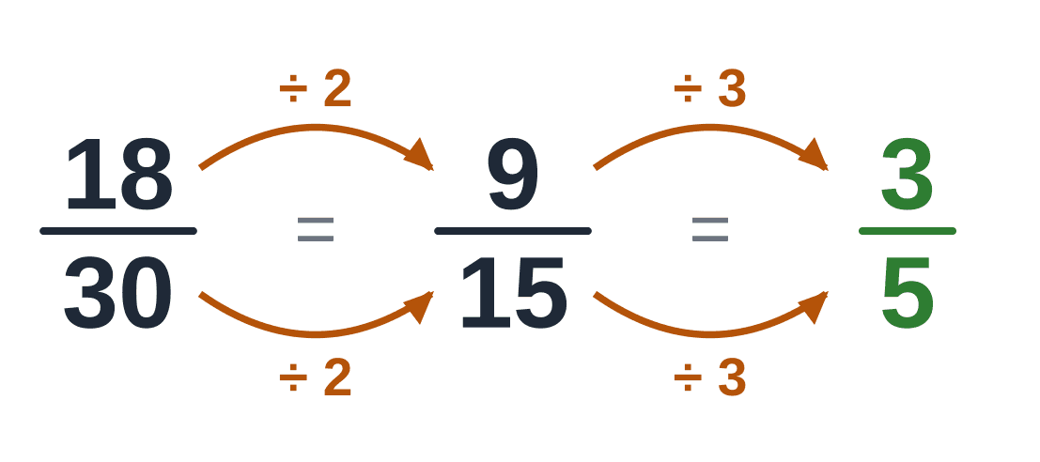
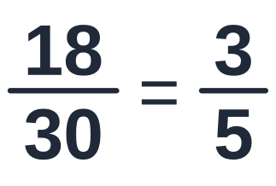
Example 1: simplify in small steps
WORKED EXAMPLE
Simplify:
3
STEP 3 OF 3
Can 3/5 be simplified again? No: 1 is the only number that goes into both 3 and 5. Finished.
Why? Small steps are safe steps. You do not have to find the biggest number in one go.
Notes:
Example 1: simplify in small steps — step 3 of 3.
DO: Can 3/5 be simplified again? No: 1 is the only number that goes into both 3 and 5. Finished.
WHY: Small steps are safe steps. You do not have to find the biggest number in one go.

Slide 22
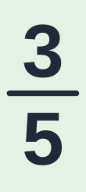
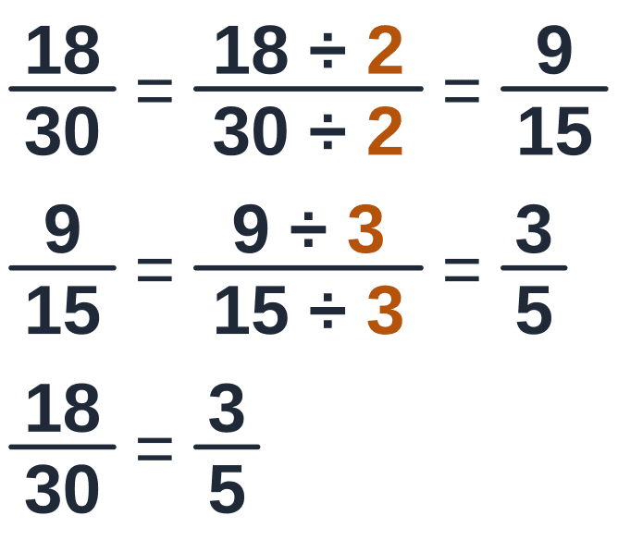
Example 1: simplify in small steps
ANSWER
Simplify:
ANSWER
HOW IT LOOKS ON YOUR PAGE
Check: Go back: 3 × 6 = 18 and 5 × 6 = 30 ✓
Notes:
Example 1: simplify in small steps — ANSWER: 3/5.
CHECK: Go back: 3 × 6 = 18 and 5 × 6 = 30 ✓
Remind them: "In the exam the steps earn the marks, not only the last line. Write every line, one under the other."

Slide 23
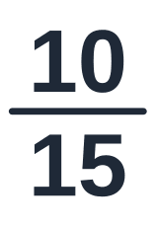
Your go: simplify 10/15
QUICK CHECK
Which number goes into both 10 and 15? Type the simplified fraction.
?
Type your answer in the chat
Notes:
QUICK CHECK. Read the question out. Everyone types an answer in the chat before you click on. Wait for at least half the group. No answers out loud yet.

Slide 24
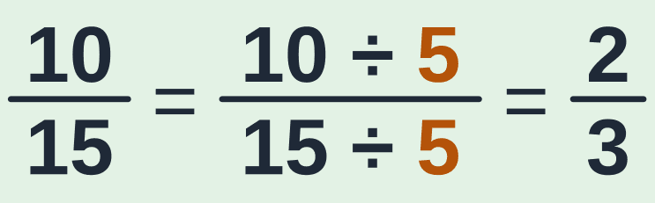
Your go: simplify 10/15
QUICK CHECK
Which number goes into both 10 and 15? Type the simplified fraction.
ANSWER
Both end in 0 or 5, so 5 goes into both: 10 ÷ 5 = 2 and 15 ÷ 5 = 3. Then 1 is the only number that goes into both 2 and 3.
Notes:
ANSWER:
WHY: Both end in 0 or 5, so 5 goes into both: 10 ÷ 5 = 2 and 15 ÷ 5 = 3. Then 1 is the only number that goes into both 2 and 3.
Name two people whose chat answers were right. If many were wrong, go back one slide and re-explain before moving on.

Slide 25
Improper fractions and mixed numbers
PART 3 OF 7 · FROM LESSON 2 · about 10 minutes
3
More slices than one whole holds
Notes:
Part 3 of 7: Improper fractions and mixed numbers. More slices than one whole holds

Slide 26
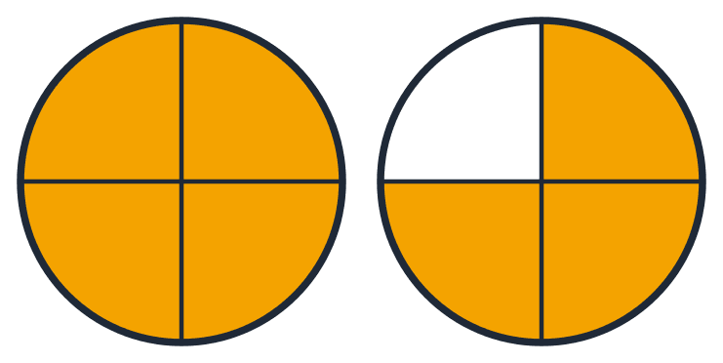
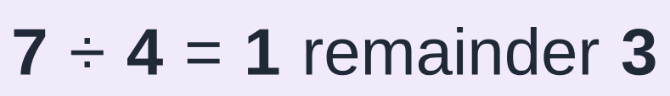
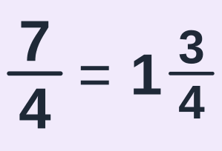
When the top is bigger than the bottom
PICTURE IT
7/4 has more slices than one pizza holds. A fraction like that is called an improper fraction.
Divide the top by the bottom: how many 4s fit into 7? One 4 fits, and 3 slices are left over.
So 7/4 is 1 whole pizza and 3 quarters: 1 3/4. That is a mixed number.
Notes:
SAY: 7 quarters: 4 of them make one whole pizza, and 3 quarters are left over.

Slide 27
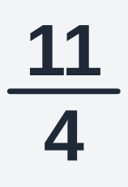
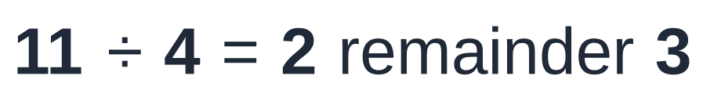
Example 2: improper fraction → mixed number
WORKED EXAMPLE
Write as a mixed number:
1
STEP 1 OF 2
Divide the top by the bottom: how many 4s fit into 11? Two 4s make 8. Three 4s make 12: too many. So 2 fit, and 11 − 8 = 3 are left over.
Why? Every 4 quarters make one whole.
Notes:
Example 2: improper fraction → mixed number — step 1 of 2.
DO: Divide the top by the bottom: how many 4s fit into 11? Two 4s make 8. Three 4s make 12: too many. So 2 fit, and 11 − 8 = 3 are left over.
WHY: Every 4 quarters make one whole.

Slide 28

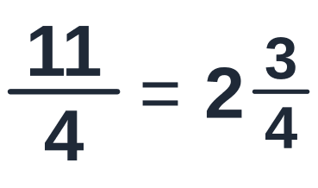
Example 2: improper fraction → mixed number
WORKED EXAMPLE
Write as a mixed number:
2
STEP 2 OF 2
The 2 is the whole number. The 3 left over is the new top. The slices are still quarters, so the bottom stays 4.
Why? The picture shows 2 whole pizzas and 3 quarters more.
Notes:
Example 2: improper fraction → mixed number — step 2 of 2.
DO: The 2 is the whole number. The 3 left over is the new top. The slices are still quarters, so the bottom stays 4.
WHY: The picture shows 2 whole pizzas and 3 quarters more.

Slide 29
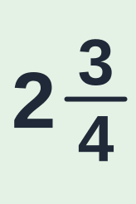
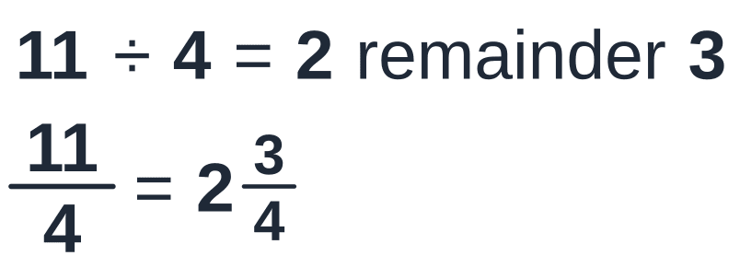
Example 2: improper fraction → mixed number
ANSWER
Write as a mixed number:
ANSWER
HOW IT LOOKS ON YOUR PAGE
Check: Go back: 2 wholes are 8 quarters, plus 3 more makes 11 quarters ✓
Notes:
Example 2: improper fraction → mixed number — ANSWER: 2 and 3/4.
CHECK: Go back: 2 wholes are 8 quarters, plus 3 more makes 11 quarters ✓
Remind them: "In the exam the steps earn the marks, not only the last line. Write every line, one under the other."

Slide 30
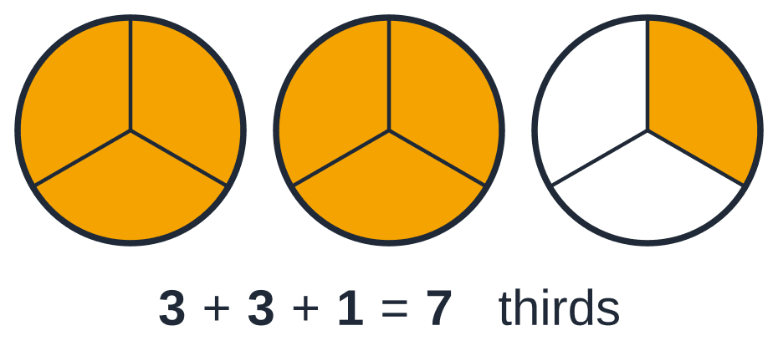
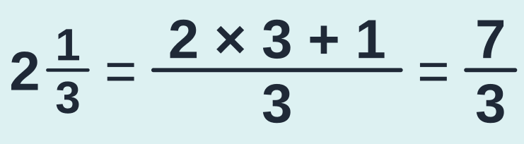
And back again: mixed number → improper fraction
TOOL
Multiply the whole number by the bottom. That turns the wholes into slices.
Add the top. Those are the extra slices.
Write the total over the same bottom.
Notes:
SAY: Each whole is 3 thirds. 2 wholes are 6 thirds, plus 1 more third makes 7 thirds.

Slide 31
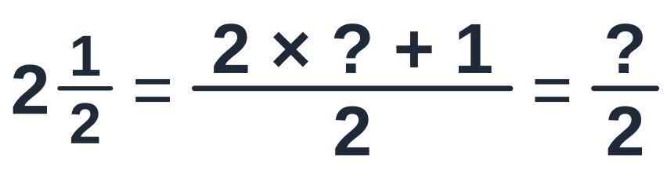
Fill in the blanks: 2 1/2 as an improper fraction
QUICK CHECK
Type only the two missing numbers, in order.
?
Type your answer in the chat
Notes:
QUICK CHECK. Read the question out. Everyone types an answer in the chat before you click on. Wait for at least half the group. No answers out loud yet.
Expect "2, 5".

Slide 32
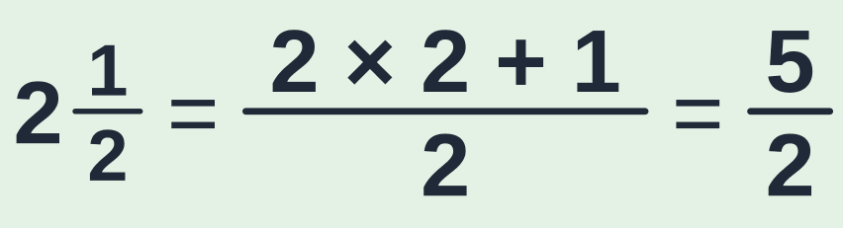
Fill in the blanks: 2 1/2 as an improper fraction
QUICK CHECK
Type only the two missing numbers, in order.
ANSWER
Whole number × bottom: 2 × 2 = 4 halves. Plus the 1 half on top: 5 halves.
Notes:
ANSWER:
WHY: Whole number × bottom: 2 × 2 = 4 halves. Plus the 1 half on top: 5 halves.
Name two people whose chat answers were right. If many were wrong, go back one slide and re-explain before moving on.

Slide 33
The sign × means "groups of": a whole number times a fraction
PART 4 OF 7 · LESSON 3, IDEA 1 · about 12 minutes
4
Multiply the top only
Notes:
Part 4 of 7: The sign × means "groups of": a whole number times a fraction. Multiply the top only

Slide 34
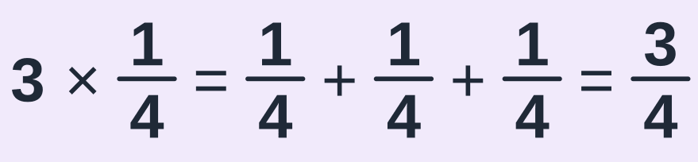
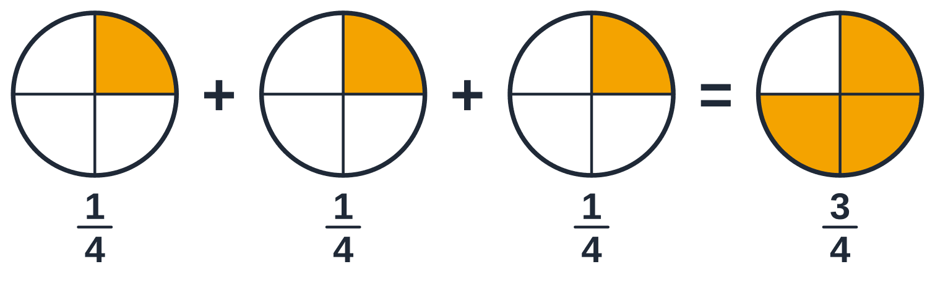
3 × 1/4 means 3 groups of a quarter
PICTURE IT
Take a quarter of a pizza, three times.
Count the slices: 1 quarter + 1 quarter + 1 quarter = 3 quarters.
Notes:
Take a quarter of a pizza, three times. Count the slices: 1 quarter + 1 quarter + 1 quarter = 3 quarters.

Slide 35
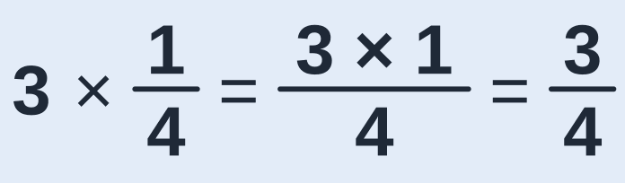
A whole number times a fraction: multiply the TOP only
THE RULE
The top counts the slices. 3 groups of 1 slice is 3 slices. So multiply the top by the whole number.
The bottom says which slices they are: quarters. They are still quarters. So the bottom stays the same.
Notes:
SAY: Have her say it back: "More groups means more slices, not bigger slices."

Slide 36
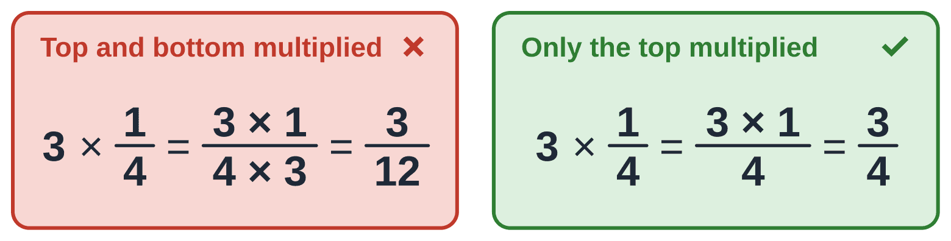
Do NOT multiply the bottom as well
CAREFUL
If you multiply the top AND the bottom by 3, you get 3/12.
3/12 simplifies back to 1/4. The amount has not changed at all. (That is the golden rule.)
Three groups of a quarter must be MORE than one quarter.
Notes:
If you multiply the top AND the bottom by 3, you get 3/12. 3/12 simplifies back to 1/4. The amount has not changed at all. (That is the golden rule.) Three groups of a quarter must be MORE than one quarter.

Slide 37
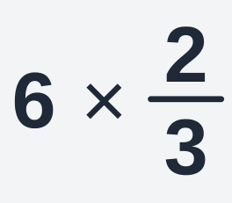
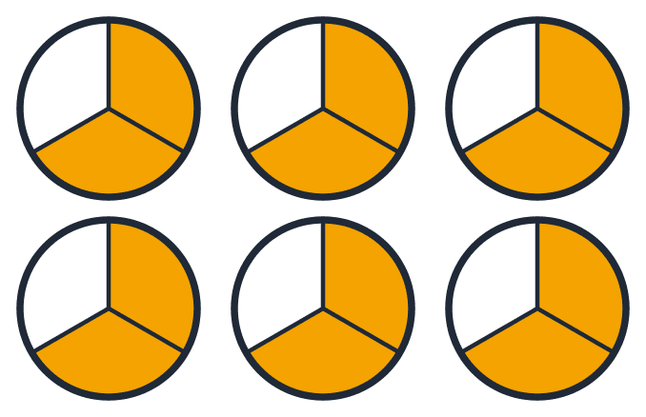
Example 3: 6 groups of two thirds (Lesson 3, Example 1)
WORKED EXAMPLE
Work out:
1
STEP 1 OF 4
Read the question out loud: "6 times two thirds". It means 6 groups of two thirds of a pizza.
Why? Saying it in words first tells you what to expect: many slices.
Notes:
Example 3: 6 groups of two thirds (Lesson 3, Example 1) — step 1 of 4.
DO: Read the question out loud: "6 times two thirds". It means 6 groups of two thirds of a pizza.
WHY: Saying it in words first tells you what to expect: many slices.

Slide 38
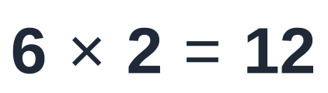
Example 3: 6 groups of two thirds (Lesson 3, Example 1)
WORKED EXAMPLE
Work out:
2
STEP 2 OF 4
Multiply the TOP by the whole number: 6 × 2 = 12. That is how many slices there are.
Why? Each group has 2 slices and there are 6 groups: 2 + 2 + 2 + 2 + 2 + 2 = 12.
Notes:
Example 3: 6 groups of two thirds (Lesson 3, Example 1) — step 2 of 4.
DO: Multiply the TOP by the whole number: 6 × 2 = 12. That is how many slices there are.
WHY: Each group has 2 slices and there are 6 groups: 2 + 2 + 2 + 2 + 2 + 2 = 12.

Slide 39
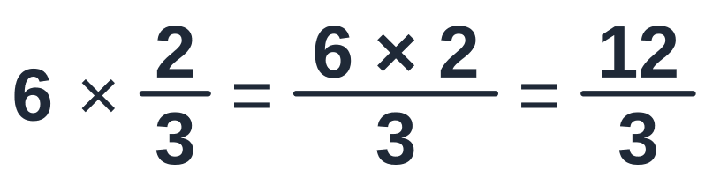
Example 3: 6 groups of two thirds (Lesson 3, Example 1)
WORKED EXAMPLE
Work out:
3
STEP 3 OF 4
The bottom stays 3, because every slice is still a third. Write 12 over 3.
Why? Multiplying changes HOW MANY slices you have. It does not change the size of the slices.
Notes:
Example 3: 6 groups of two thirds (Lesson 3, Example 1) — step 3 of 4.
DO: The bottom stays 3, because every slice is still a third. Write 12 over 3.
WHY: Multiplying changes HOW MANY slices you have. It does not change the size of the slices.

Slide 40
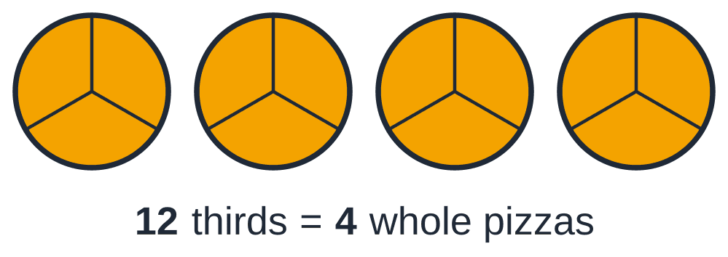
Example 3: 6 groups of two thirds (Lesson 3, Example 1)
WORKED EXAMPLE
Work out:
4
STEP 4 OF 4
The top (12) is bigger than the bottom (3), so there are whole pizzas inside. Divide the top by the bottom: how many 3s fit into 12? Four 3s make 12 exactly. Nothing is left over.
Why? Every 3 thirds make one whole pizza. 12 thirds make 4 whole pizzas.
Notes:
Example 3: 6 groups of two thirds (Lesson 3, Example 1) — step 4 of 4.
DO: The top (12) is bigger than the bottom (3), so there are whole pizzas inside. Divide the top by the bottom: how many 3s fit into 12? Four 3s make 12 exactly. Nothing is left over.
WHY: Every 3 thirds make one whole pizza. 12 thirds make 4 whole pizzas.

Slide 41
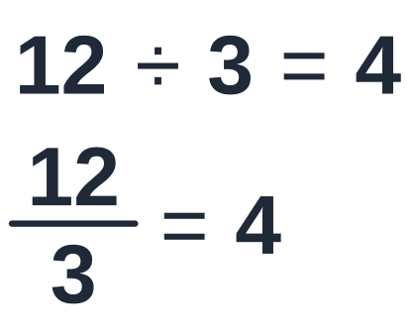
Example 3: 6 groups of two thirds (Lesson 3, Example 1)
WORKED EXAMPLE
Work out:
4
STEP 4 OF 4
The top (12) is bigger than the bottom (3), so there are whole pizzas inside. Divide the top by the bottom: how many 3s fit into 12? Four 3s make 12 exactly. Nothing is left over.
Why? Every 3 thirds make one whole pizza. 12 thirds make 4 whole pizzas.
Notes:
Example 3: 6 groups of two thirds (Lesson 3, Example 1) — step 4 of 4.
DO: The top (12) is bigger than the bottom (3), so there are whole pizzas inside. Divide the top by the bottom: how many 3s fit into 12? Four 3s make 12 exactly. Nothing is left over.
WHY: Every 3 thirds make one whole pizza. 12 thirds make 4 whole pizzas.

Slide 42

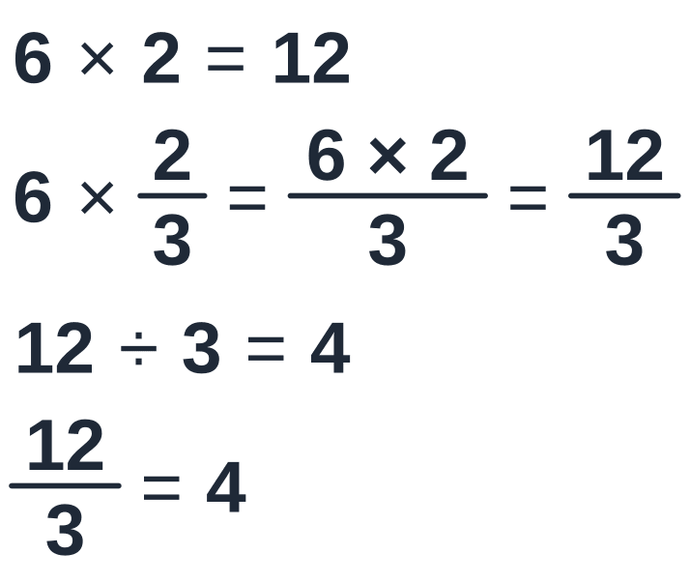
Example 3: 6 groups of two thirds (Lesson 3, Example 1)
ANSWER
Work out:
ANSWER
HOW IT LOOKS ON YOUR PAGE
Check: Two thirds is a little more than half a pizza. Six halves would be 3 pizzas. So the answer should be a little more than 3 ✓
Notes:
Example 3: 6 groups of two thirds (Lesson 3, Example 1) — ANSWER: 4.
CHECK: Two thirds is a little more than half a pizza. Six halves would be 3 pizzas. So the answer should be a little more than 3 ✓
Remind them: "In the exam the steps earn the marks, not only the last line. Write every line, one under the other."

Slide 43
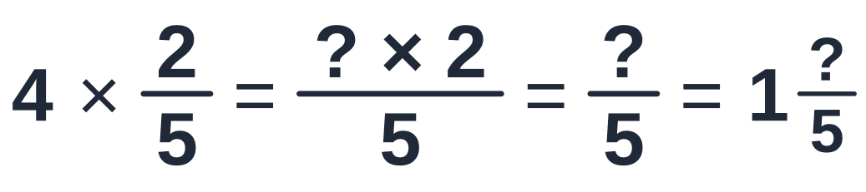
Fill in the blanks: 4 × 2/5
QUICK CHECK
Type only the three missing numbers, in order.
?
Type your answer in the chat
Notes:
QUICK CHECK. Read the question out. Everyone types an answer in the chat before you click on. Wait for at least half the group. No answers out loud yet.
Expect "4, 8, 3".

Slide 44
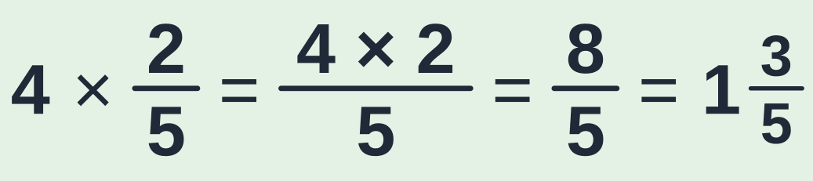
Fill in the blanks: 4 × 2/5
QUICK CHECK
Type only the three missing numbers, in order.
ANSWER
Multiply the top by the whole number: 4 × 2 = 8. The bottom stays 5. Then 8 ÷ 5 = 1 remainder 3: one whole and 3 fifths.
Notes:
ANSWER:
WHY: Multiply the top by the whole number: 4 × 2 = 8. The bottom stays 5. Then 8 ÷ 5 = 1 remainder 3: one whole and 3 fifths.
Name two people whose chat answers were right. If many were wrong, go back one slide and re-explain before moving on.

Slide 45
A fraction OF something: "of" means ×
PART 5 OF 7 · LESSON 3, IDEA 2 · about 13 minutes
5
Fraction × fraction: top × top, bottom × bottom, then simplify
Notes:
Part 5 of 7: A fraction OF something: "of" means ×. Fraction × fraction: top × top, bottom × bottom, then simplify

Slide 46
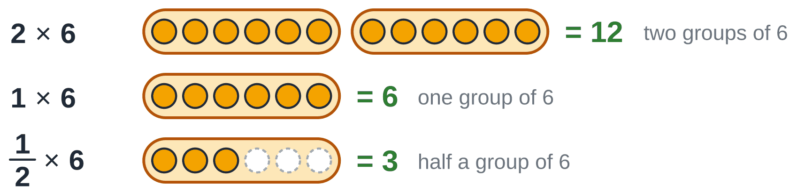
What if the number in front is a fraction? Half a group
PICTURE IT
2 × 6 is two groups of 6. That is 12.
1 × 6 is one group of 6. That is 6.
1/2 × 6 is half a group of 6. That is 3.
So 1/2 × 6 means "half OF 6". In maths, the word "of" means ×.
Notes:
2 × 6 is two groups of 6. That is 12. 1 × 6 is one group of 6. That is 6. 1/2 × 6 is half a group of 6. That is 3. So 1/2 × 6 means "half OF 6". In maths, the word "of" means ×.

Slide 47
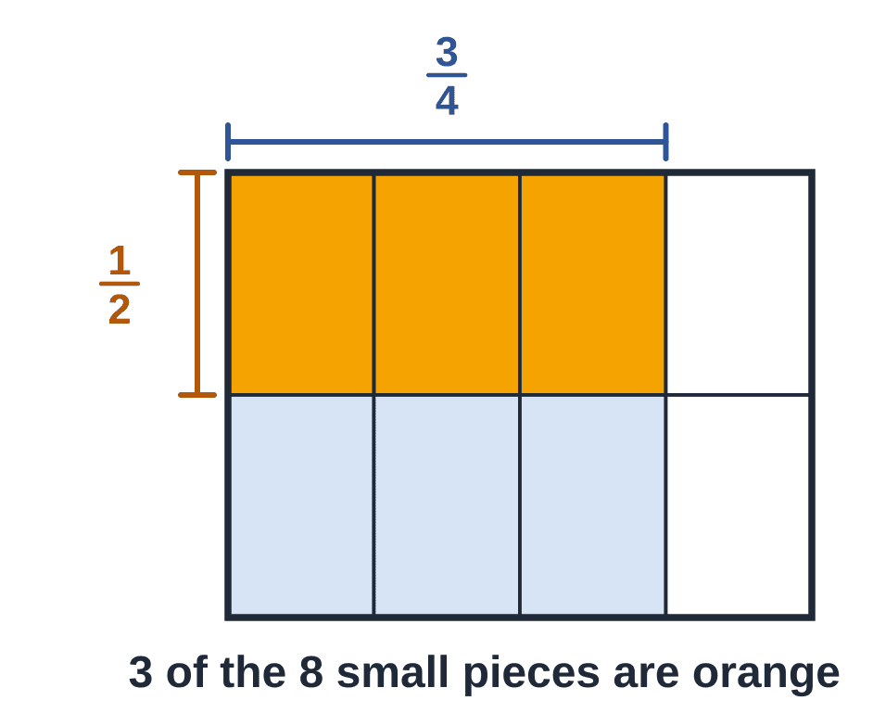
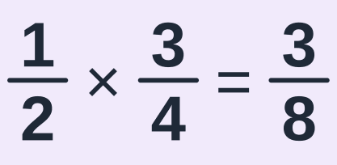
Half OF three quarters of a slab of chocolate
PICTURE IT
The slab has 4 columns. 3/4 of it is yours: the 3 coloured columns.
You give away half OF your part. Cut across the middle and take the top row: the orange part.
The whole slab is now in 8 small pieces. The orange part is 3 of those 8.
Notes:
SAY: Ask: "How many small pieces is the whole slab cut into now?" (8.) "How many are orange?" (3.)

Slide 48

Where do the 3 and the 8 come from?
WHY IT WORKS
The 8 on the bottom: 2 rows × 4 columns = 8 small pieces in the whole slab. That is bottom × bottom.
The 3 on top: 1 row × 3 columns = 3 orange pieces. That is top × top.
Notes:
The 8 on the bottom: 2 rows × 4 columns = 8 small pieces in the whole slab. That is bottom × bottom. The 3 on top: 1 row × 3 columns = 3 orange pieces. That is top × top.

Slide 49

To multiply fractions: top × top, bottom × bottom, then simplify
THE RULE
1. Multiply the tops. That is the new top.
2. Multiply the bottoms. That is the new bottom.
3. Simplify the answer if you can.
Notes:
SAY: The same three moves every time: "Tops. Bottoms. Simplify."

Slide 50


Example 4: two thirds of five sixths (Lesson 3, Example 2)
WORKED EXAMPLE
Work out:
1
STEP 1 OF 4
Read the question: "two thirds TIMES five sixths". That means two thirds OF five sixths. In the slab picture: 5 of the 6 columns, then 2 of the 3 rows.
Why? The orange part is the answer. It must be smaller than five sixths, because we only take part of it.
Notes:
Example 4: two thirds of five sixths (Lesson 3, Example 2) — step 1 of 4.
DO: Read the question: "two thirds TIMES five sixths". That means two thirds OF five sixths. In the slab picture: 5 of the 6 columns, then 2 of the 3 rows.
WHY: The orange part is the answer. It must be smaller than five sixths, because we only take part of it.

Slide 51


Example 4: two thirds of five sixths (Lesson 3, Example 2)
WORKED EXAMPLE
Work out:
2
STEP 2 OF 4
Tops first: 2 × 5 = 10. Write 10 on top of the answer.
Why? In the slab picture: 2 rows × 5 columns = 10 orange pieces.
Notes:
Example 4: two thirds of five sixths (Lesson 3, Example 2) — step 2 of 4.
DO: Tops first: 2 × 5 = 10. Write 10 on top of the answer.
WHY: In the slab picture: 2 rows × 5 columns = 10 orange pieces.

Slide 52

Example 4: two thirds of five sixths (Lesson 3, Example 2)
WORKED EXAMPLE
Work out:
3
STEP 3 OF 4
Now the bottoms: 3 × 6 = 18. Write 18 underneath.
Why? In the slab picture: 3 rows × 6 columns = 18 small pieces in the whole slab.
Notes:
Example 4: two thirds of five sixths (Lesson 3, Example 2) — step 3 of 4.
DO: Now the bottoms: 3 × 6 = 18. Write 18 underneath.
WHY: In the slab picture: 3 rows × 6 columns = 18 small pieces in the whole slab.

Slide 53

Example 4: two thirds of five sixths (Lesson 3, Example 2)
WORKED EXAMPLE
Work out:
3
STEP 3 OF 4
Now the bottoms: 3 × 6 = 18. Write 18 underneath.
Why? In the slab picture: 3 rows × 6 columns = 18 small pieces in the whole slab.
Notes:
Example 4: two thirds of five sixths (Lesson 3, Example 2) — step 3 of 4.
DO: Now the bottoms: 3 × 6 = 18. Write 18 underneath.
WHY: In the slab picture: 3 rows × 6 columns = 18 small pieces in the whole slab.

Slide 54


Example 4: two thirds of five sixths (Lesson 3, Example 2)
WORKED EXAMPLE
Work out:
4
STEP 4 OF 4
Last, simplify 10/18. Both are even, so 2 goes into both. Divide the top and the bottom by 2.
Why? Half of 10 is 5. Half of 18 is 9. Then 1 is the only number that goes into both 5 and 9, so it is finished.
Notes:
Example 4: two thirds of five sixths (Lesson 3, Example 2) — step 4 of 4.
DO: Last, simplify 10/18. Both are even, so 2 goes into both. Divide the top and the bottom by 2.
WHY: Half of 10 is 5. Half of 18 is 9. Then 1 is the only number that goes into both 5 and 9, so it is finished.

Slide 55


Example 4: two thirds of five sixths (Lesson 3, Example 2)
ANSWER
Work out:
ANSWER
HOW IT LOOKS ON YOUR PAGE
Check: Count the slab picture: 10 of the 18 small pieces are orange, and 10/18 simplifies to 5/9 ✓
Notes:
Example 4: two thirds of five sixths (Lesson 3, Example 2) — ANSWER: 5/9.
CHECK: Count the slab picture: 10 of the 18 small pieces are orange, and 10/18 simplifies to 5/9 ✓
Remind them: "In the exam the steps earn the marks, not only the last line. Write every line, one under the other."

Slide 56

Your go: 1/2 × 1/3
QUICK CHECK
Half OF a third. Top × top, bottom × bottom.
?
Type your answer in the chat
Notes:
QUICK CHECK. Read the question out. Everyone types an answer in the chat before you click on. Wait for at least half the group. No answers out loud yet.

Slide 57


Your go: 1/2 × 1/3
QUICK CHECK
Half OF a third. Top × top, bottom × bottom.
ANSWER
Tops: 1 × 1 = 1. Bottoms: 2 × 3 = 6. Half of a third is a sixth. Nothing to simplify.
Notes:
ANSWER:
WHY: Tops: 1 × 1 = 1. Bottoms: 2 × 3 = 6. Half of a third is a sixth. Nothing to simplify.
Name two people whose chat answers were right. If many were wrong, go back one slide and re-explain before moving on.

Slide 58
A whole number or a mixed number in a multiplication
PART 6 OF 7 · LESSON 3, IDEA 3 · about 5 minutes
6
Turn everything into a plain fraction first
Notes:
Part 6 of 7: A whole number or a mixed number in a multiplication. Turn everything into a plain fraction first

Slide 59

First turn every number into a plain fraction
THE RULE
A plain fraction is just a top and a bottom, with no whole number in front.
A whole number: write it over 1. 3 = 3/1, because 3 ÷ 1 is still 3.
A mixed number: change it into an improper fraction (Part 3).
Then multiply as before: top × top, bottom × bottom.
Notes:
A plain fraction is just a top and a bottom, with no whole number in front. A whole number: write it over 1. 3 = 3/1, because 3 ÷ 1 is still 3. A mixed number: change it into an improper fraction (Part 3). Then multiply as before: top × top, bottom × bottom.

Slide 60


Example 5: three groups of one and a half
WORKED EXAMPLE
Work out:
1
STEP 1 OF 3
Make both numbers plain fractions. 3 is 3/1. And 1 1/2 is 3/2, because 1 × 2 + 1 = 3.
Why? One whole is 2 halves, plus 1 more half makes 3 halves.
Notes:
Example 5: three groups of one and a half — step 1 of 3.
DO: Make both numbers plain fractions. 3 is 3/1. And 1 1/2 is 3/2, because 1 × 2 + 1 = 3.
WHY: One whole is 2 halves, plus 1 more half makes 3 halves.

Slide 61

Example 5: three groups of one and a half
WORKED EXAMPLE
Work out:
2
STEP 2 OF 3
Tops: 3 × 3 = 9. Bottoms: 1 × 2 = 2.
Why? Top × top, bottom × bottom.
Notes:
Example 5: three groups of one and a half — step 2 of 3.
DO: Tops: 3 × 3 = 9. Bottoms: 1 × 2 = 2.
WHY: Top × top, bottom × bottom.

Slide 62

Example 5: three groups of one and a half
WORKED EXAMPLE
Work out:
3
STEP 3 OF 3
The top is bigger than the bottom. Divide: how many 2s fit into 9? Four 2s make 8, and 1 is left over.
Why? Every 2 halves make one whole.
Notes:
Example 5: three groups of one and a half — step 3 of 3.
DO: The top is bigger than the bottom. Divide: how many 2s fit into 9? Four 2s make 8, and 1 is left over.
WHY: Every 2 halves make one whole.

Slide 63



Example 5: three groups of one and a half
ANSWER
Work out:
ANSWER
HOW IT LOOKS ON YOUR PAGE
Check: In money: 3 groups of R1.50 is R4.50 ✓
Notes:
Example 5: three groups of one and a half — ANSWER: 4 and 1/2.
CHECK: In money: 3 groups of R1.50 is R4.50 ✓
Remind them: "In the exam the steps earn the marks, not only the last line. Write every line, one under the other."

Slide 64
A fraction OF an amount
PART 7 OF 7 · LESSON 3, IDEA 4 · about 10 minutes
7
Divide by the bottom, then multiply by the top
Notes:
Part 7 of 7: A fraction OF an amount. Divide by the bottom, then multiply by the top

Slide 65

What is 2/5 of R100?
PICTURE IT
"2/5 OF R100" means: share the R100 into 5 equal parts, then take 2 of the parts.
One part: R100 ÷ 5 = R20. (Five R20 notes make R100.)
Two parts: 2 × R20 = R40.
Notes:
SAY: Before you show this slide, ask: "If five people share R100 equally, how much does each get?" Then: "And two of them together?"

Slide 66


Divide by the bottom, then multiply by the top
THE RULE
÷ bottom gives the size of ONE part. (The bottom says how many equal parts there are.)
× top takes as many parts as you need. (The top says how many parts you want.)
Notes:
SAY: Two small calculations, always in this order: divide by the bottom, multiply by the top.

Slide 67
Dividing a number that ends in 0
TOOL
For 120 ÷ 4, leave the 0 off: 12 ÷ 4 = 3. Then put the 0 back: 30.
Why? 120 is 12 tens. 12 tens shared by 4 is 3 tens, which is 30.
Check by multiplying back: 4 × 30 = 120 ✓
Notes:
For 120 ÷ 4, leave the 0 off: 12 ÷ 4 = 3. Then put the 0 back: 30. Why? 120 is 12 tens. 12 tens shared by 4 is 3 tens, which is 30. Check by multiplying back: 4 × 30 = 120 ✓

Slide 68

Example 6: the staff canteen (Lesson 3, Example 5)
WORKED EXAMPLE
A company has 120 staff. 3/4 of them use the canteen. How many staff use the canteen?
1
STEP 1 OF 4
Find the fraction and the amount. The fraction is 3/4. The amount is 120 staff. "3/4 OF 120" means: split the staff into 4 equal groups and take 3 of the groups.
Why? The bottom (4) says how many equal groups. The top (3) says how many groups we want.
Notes:
Example 6: the staff canteen (Lesson 3, Example 5) — step 1 of 4.
DO: Find the fraction and the amount. The fraction is 3/4. The amount is 120 staff. "3/4 OF 120" means: split the staff into 4 equal groups and take 3 of the groups.
WHY: The bottom (4) says how many equal groups. The top (3) says how many groups we want.

Slide 69


Example 6: the staff canteen (Lesson 3, Example 5)
WORKED EXAMPLE
A company has 120 staff. 3/4 of them use the canteen. How many staff use the canteen?
2
STEP 2 OF 4
Divide by the bottom to find ONE group: 120 ÷ 4. Think of 12 ÷ 4 = 3, so 120 ÷ 4 = 30.
Why? 120 is 12 tens. 12 tens shared by 4 is 3 tens, which is 30. Check: 30 + 30 + 30 + 30 = 120.
Notes:
Example 6: the staff canteen (Lesson 3, Example 5) — step 2 of 4.
DO: Divide by the bottom to find ONE group: 120 ÷ 4. Think of 12 ÷ 4 = 3, so 120 ÷ 4 = 30.
WHY: 120 is 12 tens. 12 tens shared by 4 is 3 tens, which is 30. Check: 30 + 30 + 30 + 30 = 120.

Slide 70


Example 6: the staff canteen (Lesson 3, Example 5)
WORKED EXAMPLE
A company has 120 staff. 3/4 of them use the canteen. How many staff use the canteen?
3
STEP 3 OF 4
Multiply by the top to get THREE groups: 3 × 30 = 90.
Why? 3 groups of 30: 30 + 30 + 30 = 90.
Notes:
Example 6: the staff canteen (Lesson 3, Example 5) — step 3 of 4.
DO: Multiply by the top to get THREE groups: 3 × 30 = 90.
WHY: 3 groups of 30: 30 + 30 + 30 = 90.

Slide 71

Example 6: the staff canteen (Lesson 3, Example 5)
WORKED EXAMPLE
A company has 120 staff. 3/4 of them use the canteen. How many staff use the canteen?
4
STEP 4 OF 4
Check: the one group left over (30 people) does not use the canteen. The two numbers together must be everyone.
Why? The people who use it plus the people who do not must add up to all 120 staff.
Notes:
Example 6: the staff canteen (Lesson 3, Example 5) — step 4 of 4.
DO: Check: the one group left over (30 people) does not use the canteen. The two numbers together must be everyone.
WHY: The people who use it plus the people who do not must add up to all 120 staff.

Slide 72

Example 6: the staff canteen (Lesson 3, Example 5)
ANSWER
A company has 120 staff. 3/4 of them use the canteen. How many staff use the canteen?
ANSWER
HOW IT LOOKS ON YOUR PAGE
90 staff use the canteen.
Notes:
Example 6: the staff canteen (Lesson 3, Example 5) — ANSWER: 90 staff use the canteen..
Remind them: "In the exam the steps earn the marks, not only the last line. Write every line, one under the other."

Slide 73
You have caught up with the group
LOOK
The group stopped at the end of this example.
Next session you continue together from Lesson 3, Worked example 6 ("the part that is left").
After that comes Idea 5 of Lesson 3: dividing fractions.
Notes:
SAY: Tell her where to find Worked example 6 in her Lesson 3 notes, in case she wants to look ahead.

Slide 74


Exit ticket: do these on your own
EXIT TICKET
1 / 2
1
Simplify:
2
Work out:
Send a photo of your working to your tutor privately. It is not for marks.
Notes:
Exit ticket. 5 minutes, silent. They send working privately. Do NOT show the next slides until everyone has sent something.

Slide 75
Exit ticket: do these on your own
EXIT TICKET
2 / 2
3
Find 3/5 of R200.
Send a photo of your working to your tutor privately. It is not for marks.
Notes:
Exit ticket. 5 minutes, silent. They send working privately. Do NOT show the next slides until everyone has sent something.

Slide 76

Exit ticket 1
EXIT TICKET · SOLUTION
Simplify:
1
STEP 1 OF 2
Both are even: divide the top and the bottom by 2.
Notes:
Exit ticket 1 — step 1 of 2.
DO: Both are even: divide the top and the bottom by 2.

Slide 77

Exit ticket 1
EXIT TICKET · SOLUTION
Simplify:
2
STEP 2 OF 2
Both are still even: divide by 2 again. Then 1 is the only number that goes into both 3 and 4.
Notes:
Exit ticket 1 — step 2 of 2.
DO: Both are still even: divide by 2 again. Then 1 is the only number that goes into both 3 and 4.

Slide 78


Exit ticket 1
ANSWER
Simplify:
ANSWER
HOW IT LOOKS ON YOUR PAGE
Notes:
Exit ticket 1 — ANSWER: 3/4.
Remind them: "In the exam the steps earn the marks, not only the last line. Write every line, one under the other."

Slide 79


Exit ticket 2
EXIT TICKET · SOLUTION
Work out:
1
Top × top, bottom × bottom.
2
Simplify: 6 goes into both 6 and 12.
ANSWER
Notes:
Exit ticket 2.
1. Top × top, bottom × bottom.
2. Simplify: 6 goes into both 6 and 12.
ANSWER: 1/2

Slide 80

Exit ticket 3
EXIT TICKET · SOLUTION
Find 3/5 of R200.
1
Divide by the bottom: 200 ÷ 5. Leave a 0 off: 20 ÷ 5 = 4. Put the 0 back: 40.
2
Multiply by the top.
ANSWER
R120
Notes:
Exit ticket 3.
1. Divide by the bottom: 200 ÷ 5. Leave a 0 off: 20 ÷ 5 = 4. Put the 0 back: 40.
2. Multiply by the top.
ANSWER: R120

Slide 81




Homework: before the next lesson
HOMEWORK
1 / 2
1
Simplify:
2
Write as a mixed number:
3
Work out:
4
Work out:
Every question has its full working in your notes. Cover it, try the question, then compare line by line.
Notes:
Set the homework. The full step-by-step working is in the student notes, and the next deck opens with a homework check.

Slide 82
Homework: before the next lesson
HOMEWORK
2 / 2
5
A shop takes R240 in a morning. 3/8 of it is for cold drinks. How much is that?
6
Read these parts of your notes, in this order, before the BODMAS lesson. Try each question before you look at its working.
Every question has its full working in your notes. Cover it, try the question, then compare line by line.
Notes:
Set the homework. The full step-by-step working is in the student notes, and the next deck opens with a homework check.

Slide 83
Today in a few lines
RECAP
1
× means "groups of". ÷ asks "how many groups fit?" The times table does both.
2
A fraction: the bottom says how many equal slices make one whole. The top counts the slices you have.
3
Simplify: divide the top and the bottom by a number that goes into both, until only 1 goes into both.
4
Improper → mixed: divide the top by the bottom. Mixed → improper: whole number × bottom, plus the top.
5
Whole number × fraction: multiply the top only. Fraction × fraction: top × top, bottom × bottom, then simplify.
6
A fraction OF an amount: divide by the bottom, then multiply by the top.
Next lesson: With the group: Lesson 3 from Worked example 6 ("the part that is left"), then dividing fractions.
Notes:
Read each line and ask one person to give an example for it. Preview: With the group: Lesson 3 from Worked example 6 ("the part that is left"), then dividing fractions.

